Slide 1



LOOK BACK 4
Part 1

Slide 2
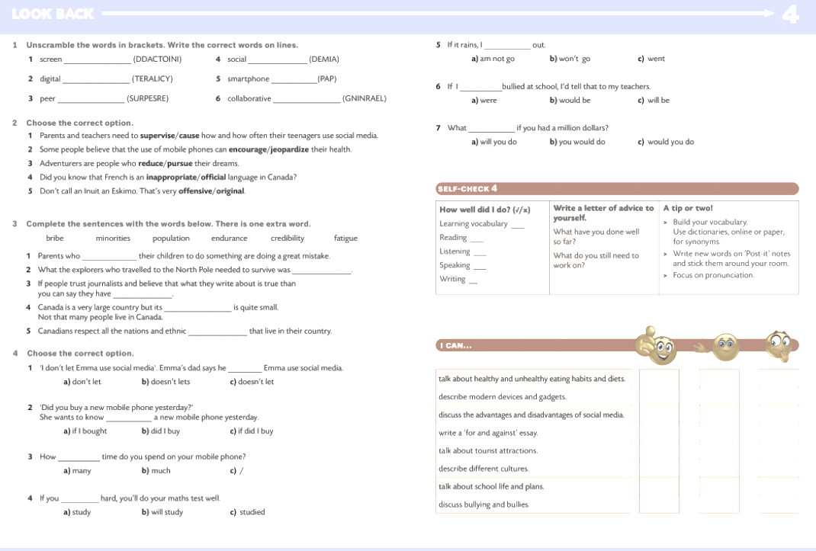


addiction
media
literacy
app
pressure
learning

Slide 3
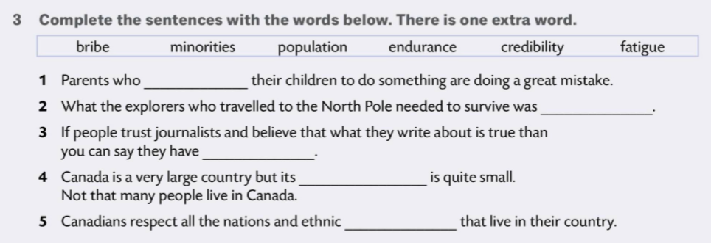
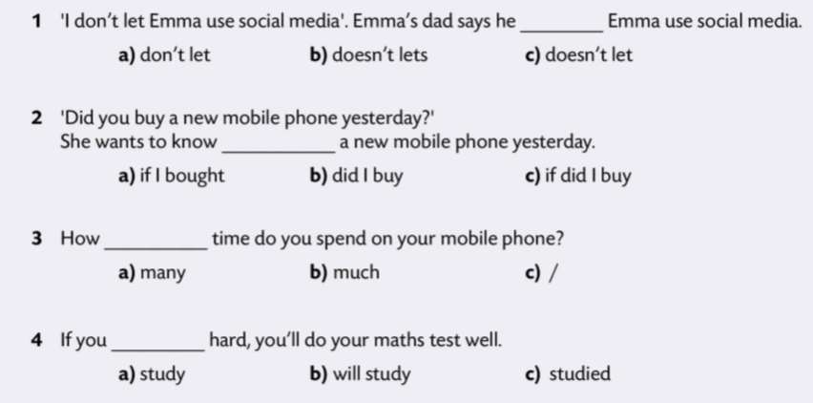

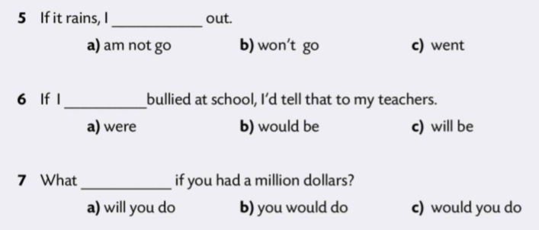
bribe
endurance
credibility
population
minorities

Slide 4
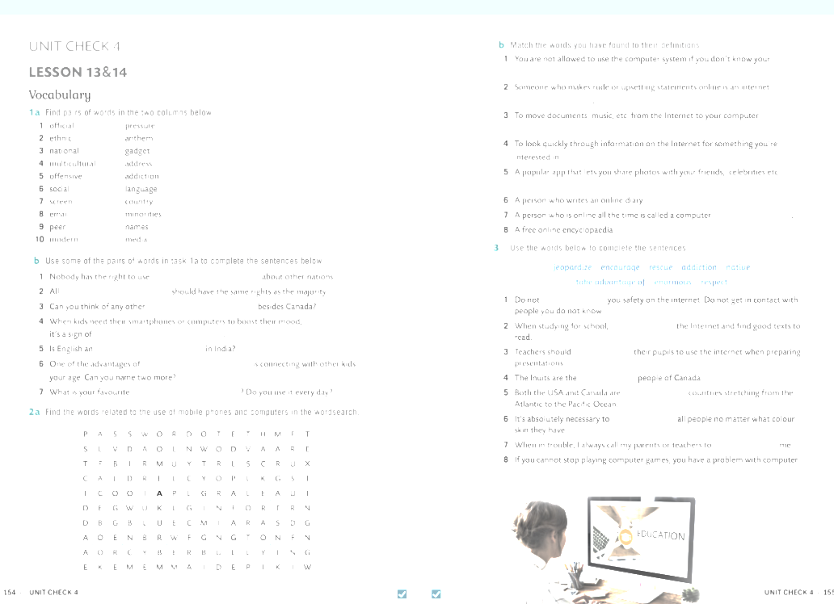
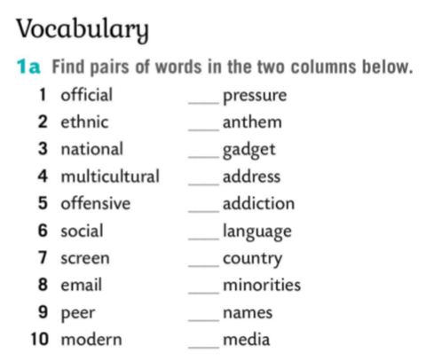
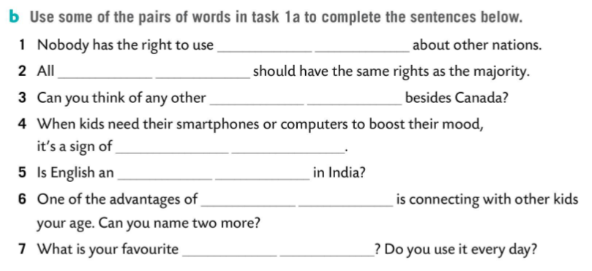
9
3
10
8
7
offensive names
1
ethnic minorities
4
multicultural country
2
5
screen addiction
6
official language
social media
modern gadget

Slide 5
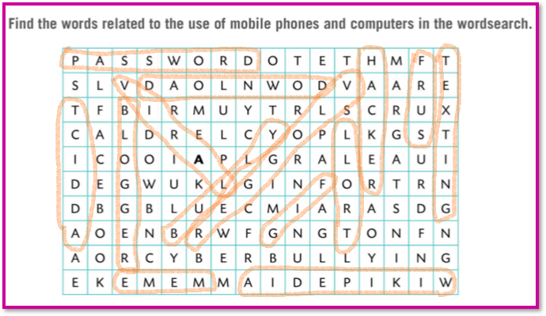
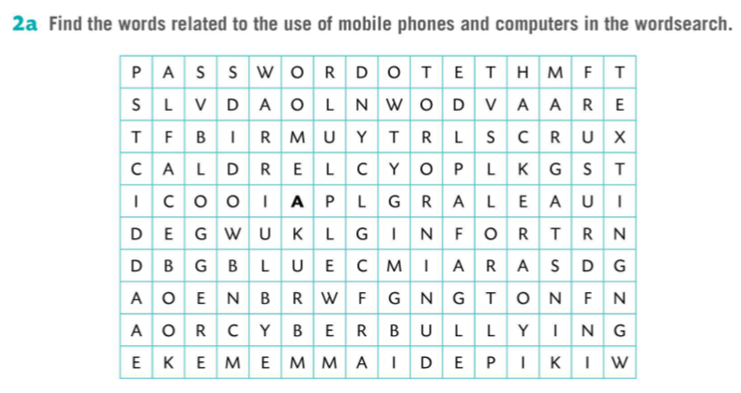
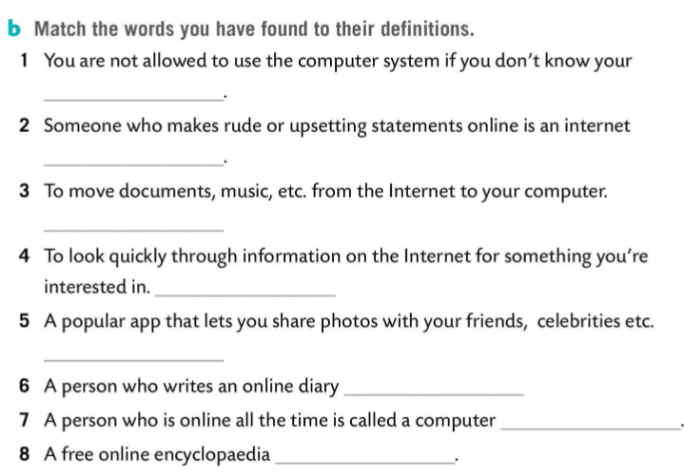
password
bully
download
surf
surf
blogger
addict
Wikipedia

Slide 6

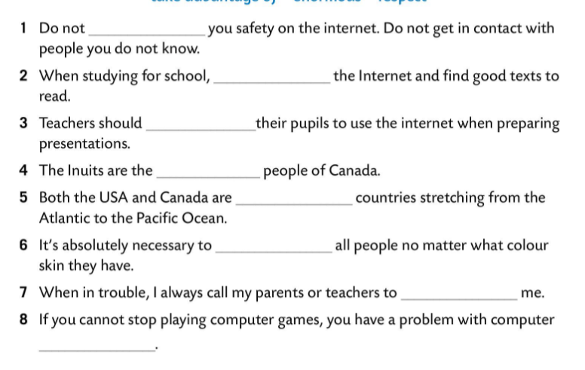
jeopardize
take advantage of
encourage
native
enormous
respect
rescue
addiction

